Slide 1

CPU Multi-level Scheduling Simulation
Instructors: Dr.Fazilah Haron Ms.Amal Albalawi
College of computer and cyber science
Department of computer science
CS 221 – Fundamental of operating system

Slide 2
Table of contents
01
02
03
Introduction to CPU scheduling
Our Implementation
- FCFS
- RR
Multilevel[2]
Multilevel[3]
Demo

Slide 3
01
Introduction

Slide 4
02
Our Implementation

Slide 5
1. FCFS?
1. First Come First Serve
Step 3: Calculate the end time of each process
For the first process:
1) If its arrival time > 0 (There’s idle time)
- Idle time = process’s arrival time
- End time = burst time + idle time
2) Else
- End time = burst time
For other processes:
a) If the arrival time > previous process end time:
Idle time =process arrival time– previous process end time
End time = previous process end time + burst time + idle time
b) Else
End time = previous process end time + burst time

Slide 6
Step 4: Calculate waiting time and turnaround time of each process.
- Turnaround time = end time – arrival time
- Waiting time = turnaround time – burst time
Step 5: Calculate the average waiting time & average turnaround time
- Calculate the total waiting time\ total turnaround time
- Divide the total by the number of processes
Step 6: Display the result & write them in the file.

Slide 7
2. RR?
2. Round Robin
Step 1: enter the first process in the main array to the ready queue & increment the number of processes in ready queue.
- readyQ[0] = procArray[0];
pInRQ++;
Step 2: check if there’s idle time before starting the execution
a) If arrival time > 0:
- Idle time = arrival time
- Current time=current time+ idle time
Step 3: for each process in the ready queue
1) If remaining time < q:
- Current time = current time + remaining time
- Remaining time =0
2) If remaining time > q:
- Remaining time = remaining time q
- Current time = current time + q
Add the process again to the ready queue
P++ //Increment number of processes in the ready queue
3) Check if a process arrived
For each process in the main array (If arrival time <= current time):
- ReadyQ[p]= process //Add it to ready queue
- P++ //Increment number of processes in ready queue

Slide 8
4) Check if there’s idle time between the processes
If (next process arrive_t >= currentTime):
Idle time = next process arrival time – current time
Current time = current time + idle time
Add the process to ready queue & in the crement number of processes in ready queue
readyQ[p]= process
p++
Step 4: Calculate the waiting time and turnaround time of each process.
Step 5: Calculate the average waiting time & average turnaround time
Step 6: Display the result & write them in the file.

Slide 9
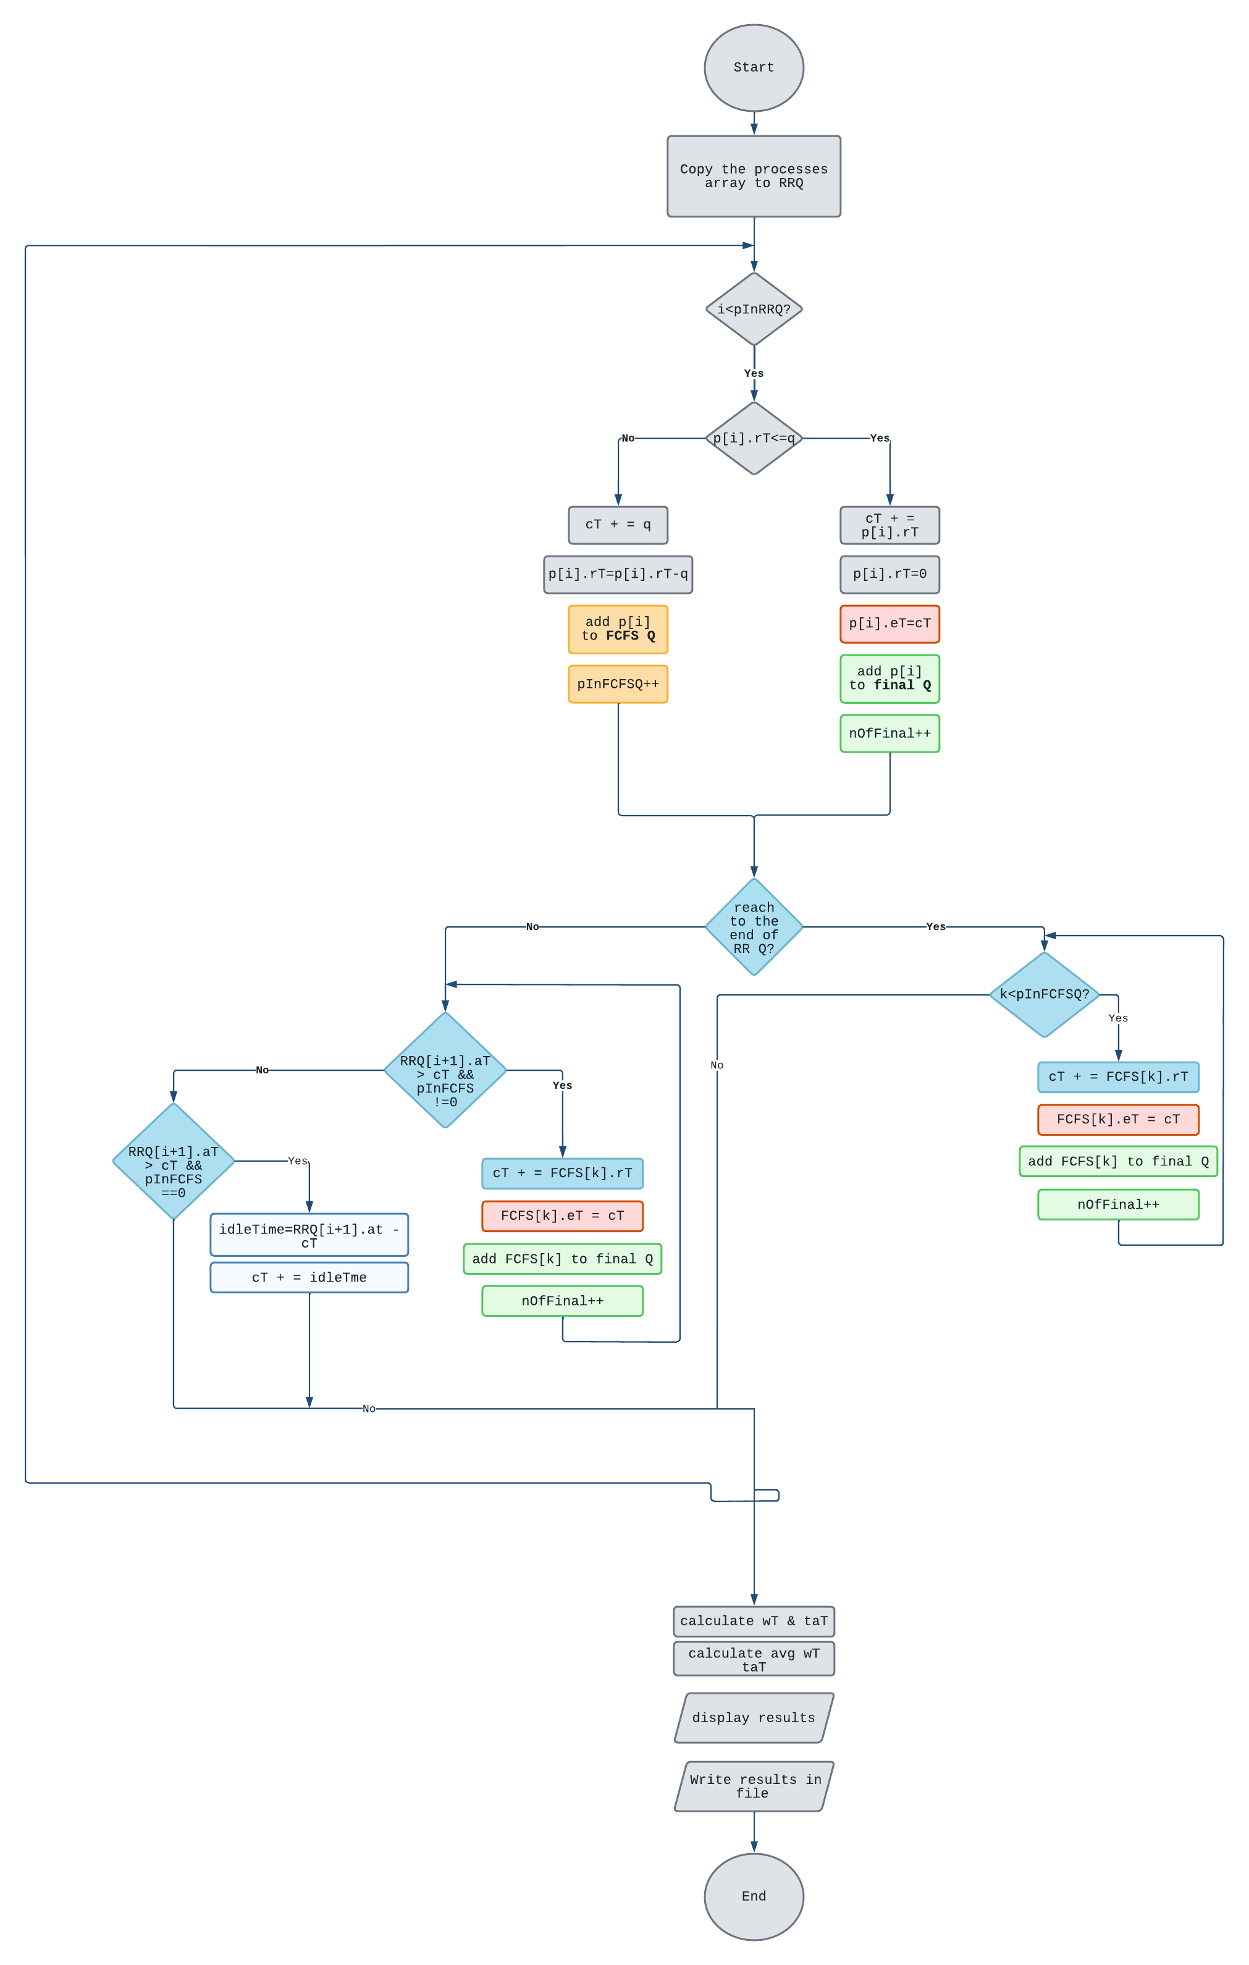
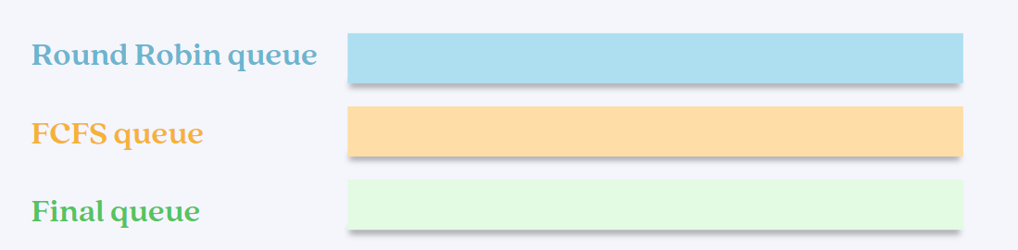
3.Multilevel Scheduling [2 Queues]

Slide 10
3.Multilevel Scheduling [2 Queues]

Slide 11
3.Multilevel Scheduling [2 Queues]

Slide 12
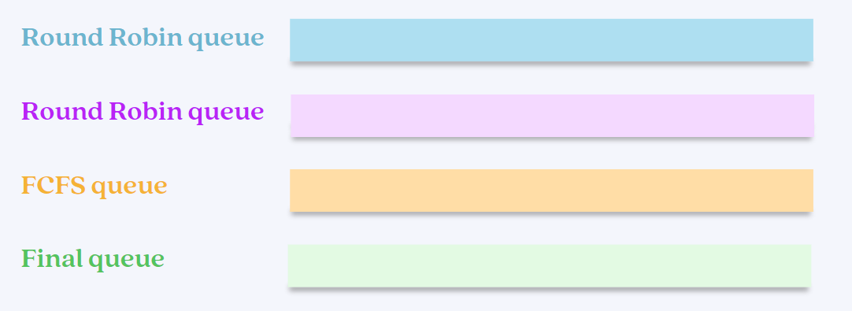
4.Multilevel Scheduling [3 Queues]

Slide 13
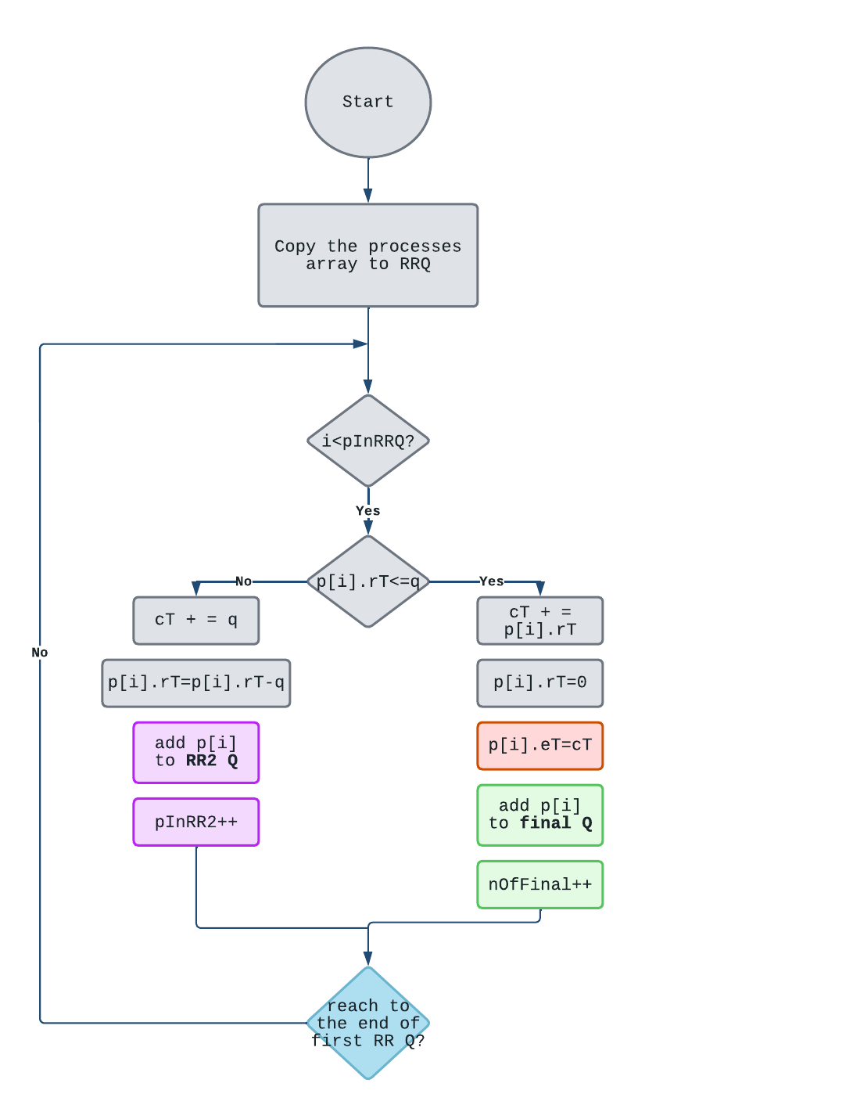
4.Multilevel Scheduling [3 Queues]

Slide 14
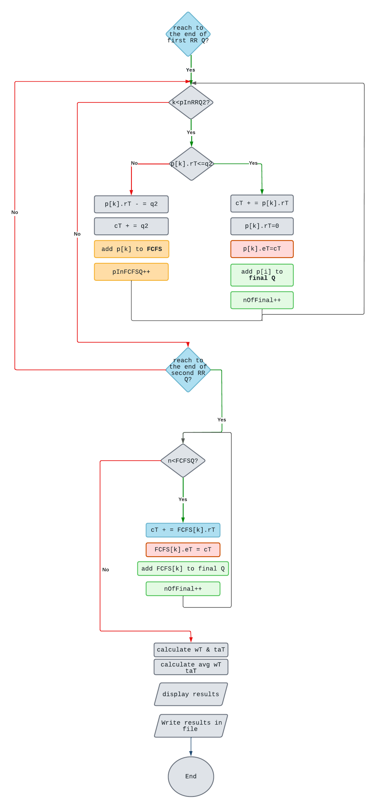
4.Multilevel Scheduling [3 Queues]

Slide 15
4.Multilevel Scheduling [3 Queues]

Slide 16
03
DEMO

Slide 17
Thanks!
Do you have any questions?
Presented by:
Reem Bayazid
Sara Alamri
Fatima Jalmoud
Ghada Bari
Saliha Hamidullah

